Slide 1



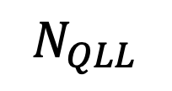
Water vapor
Deposition & ablation
Surface diffusion
$$N_{QLL}$$
QLL
$$N_{tot}$$
Quasi-liquid/ice equilibration
$$N_{ice}$$
Ice

